Slide 1
2024
NeuralGrader
Quiz Checking Using LLMs
Web App

Slide 2
About Us
We are intrepid senior-year undergraduates at NUST, fueled by our fervent passion for the wonders of AI.

Slide 3

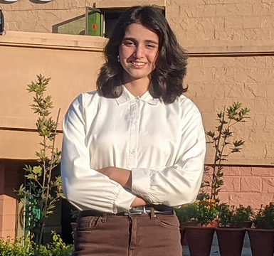

Our
Team
Muhammad Anser
Zuha Fatima
Zohair Shakeel

Slide 4
Problem
Assessing handwritten quizzes or assignments, can be a laborious endeavor, fraught with the potential for human error—especially when navigating diverse formats for example Python scripts, biological illustrations, and intricate circuit designs.
A desire arises for a tool that can assess and appraise various elements, identifying errors without necessitating specialized knowledge in any particular domain.

Slide 5
Solution
NeuralGrader, a user-friendly web application that automates quiz evaluation by utilizing advanced Large Language Models (LLMs) tailored for text and diagram analysis.
NeurallGrader conjures a remarkable time-saving spell, slashing efforts by over 90 percent. Best of all, it is a free enchantment and a premier alternative.

Slide 6
Essential tools / premier offerings
Frontend: HTML, Flask (UI/UX optimized for ease of use).
Backend: Google-Gemini-Flash-1.5-Pro via Google Cloud API for OCR.
LLMs: Integrated thoughtfully handpicked LLMs for diverse quiz types like Python programs, biological diagrams, and circuit logic.

Slide 7
Workflow
Write Prompot
Choose Desired Model
Upload Quiz
Evaluate
Simply snap a photo of any quiz or assignment you'd like to assess and upload it with ease.
While it's optional, feel free to customize it to suit your needs.
Select from our thoughtfully curated collection of LLMs that best fit your needs.
To receive an evaluated quiz or assignment, simply click on the "Evaluate" button.

Slide 8
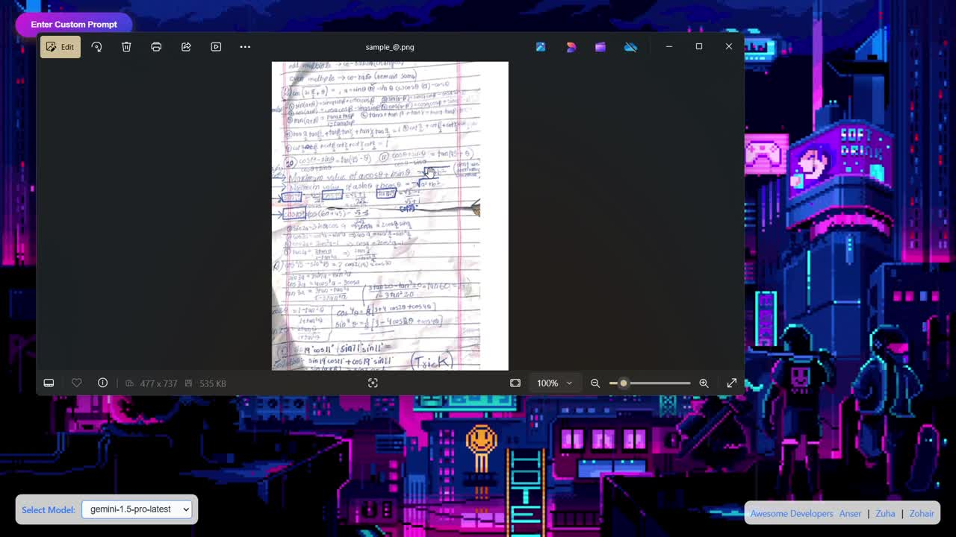
Grading a chaotic handwritten quiz in half a minute.

Slide 9
Potential Impacts
Time Efficiency:
Dramatically diminishes the hours spent on manual grading.
Scalability:
Perfectly suited for educational realms and virtual learning landscapes.
Accessibility:
Empowers educators to navigate intricate assessments effortlessly, enriching the learning journey.
No Need for Expertise:
With NeuralGrader, mastery in a specific domain is no longer a prerequisite.

Slide 10

Tests

Slide 11
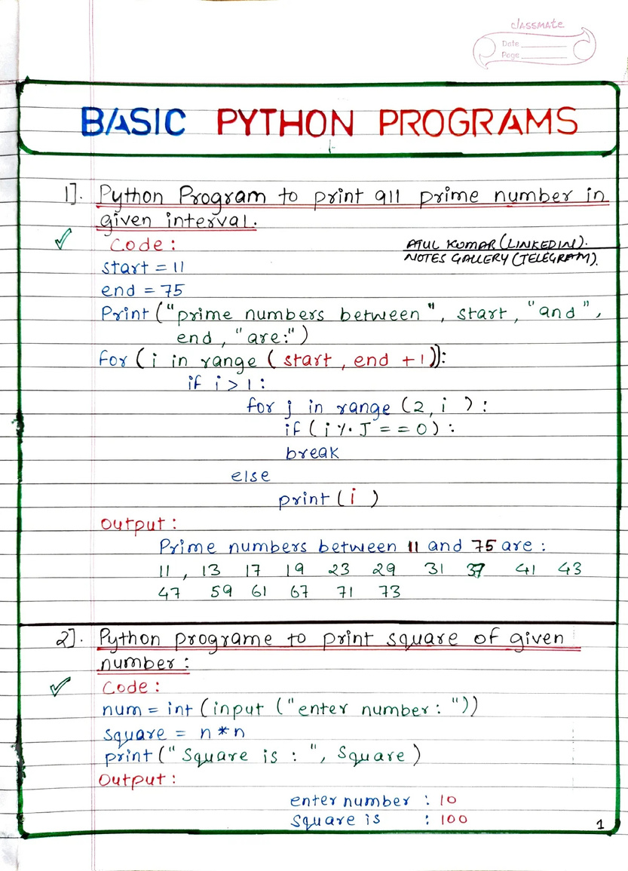
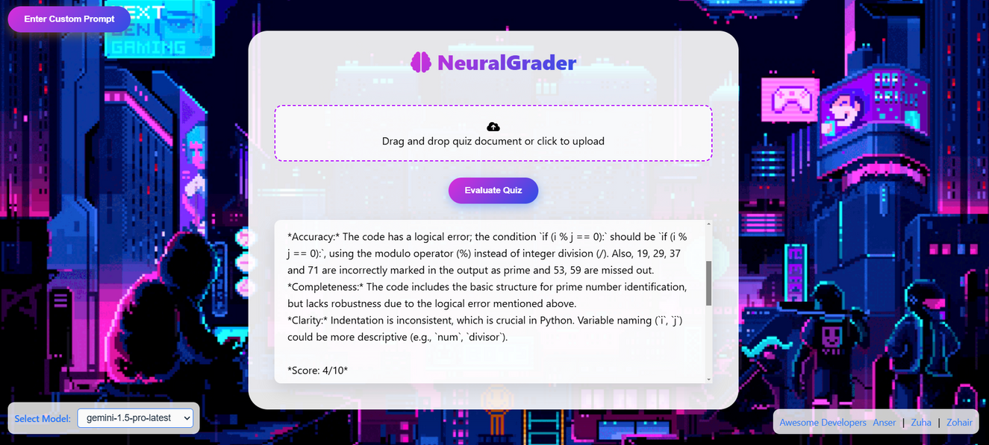
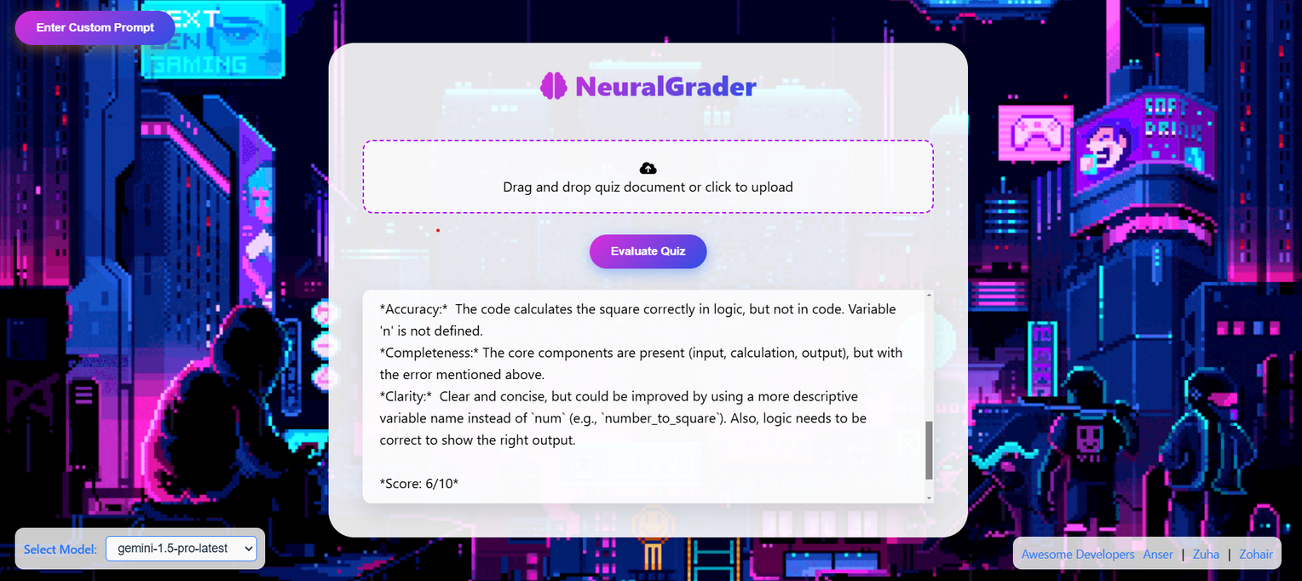
Handwritten Python Programs

Slide 12
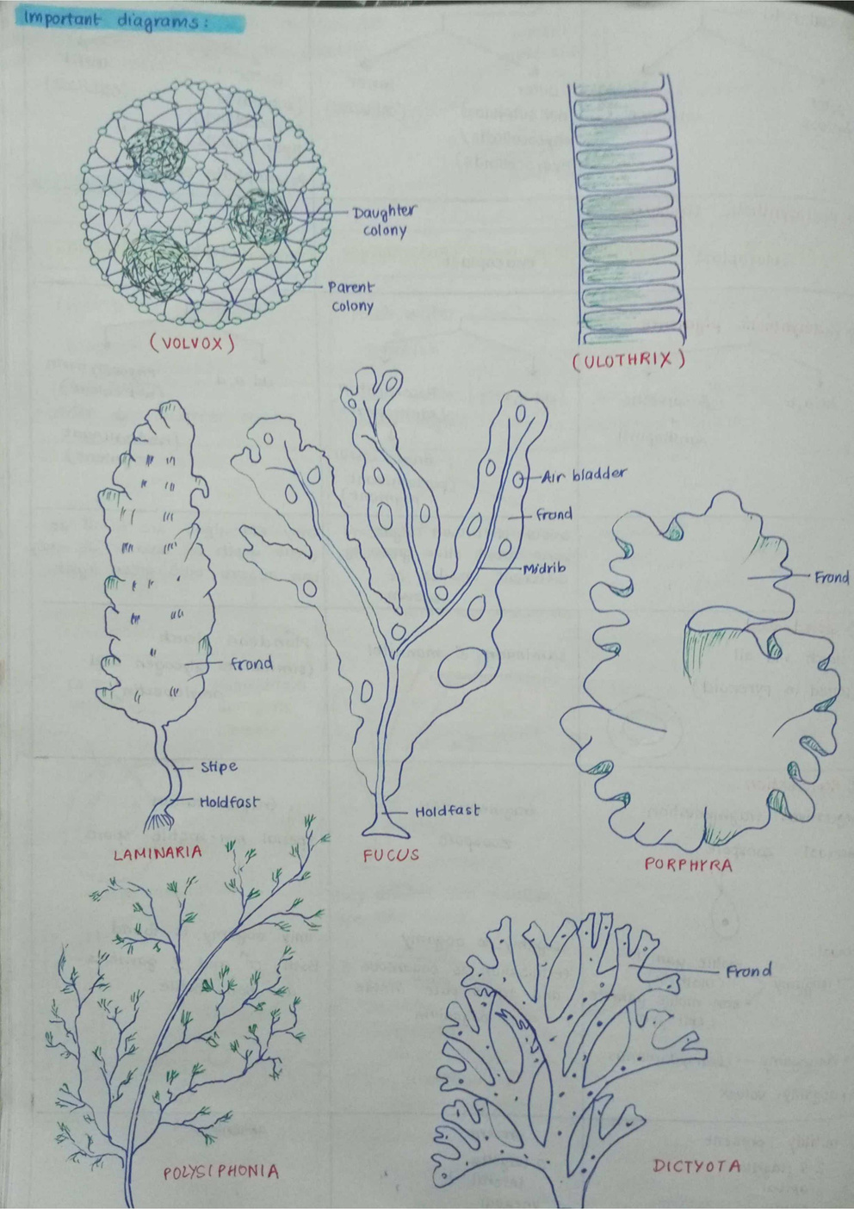
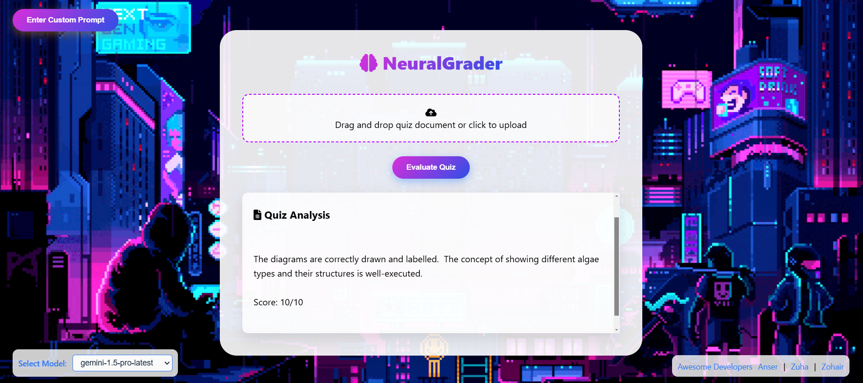
Biological Diagrams

Slide 13
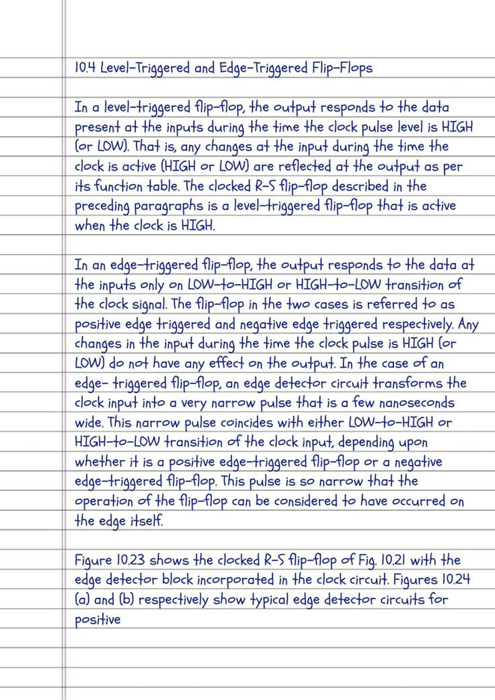
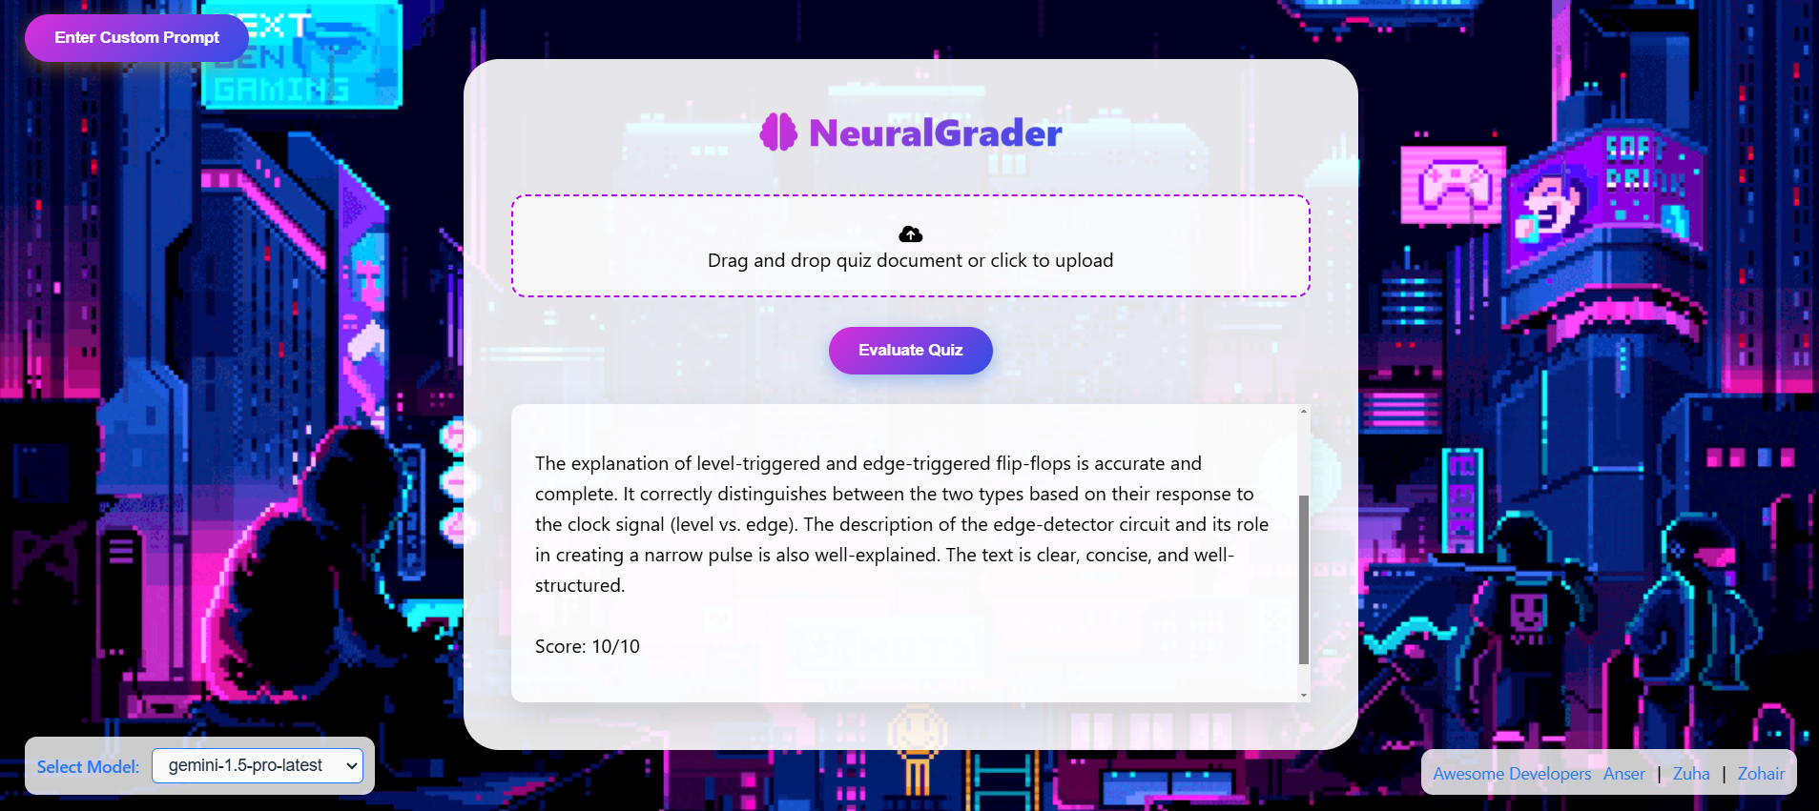
Flip FLops

Slide 14
Thank
You!
Questions? Reach Out Here:
ansersohaib.study@gmail.com

